Slide 1


SAP CLOUD APPLICATION PROGRAMMING AND XSA TRAINING IN BPT
Anubhav Oberoy
Day – 5

Slide 2

Agenda – Day 5
Concept of Localization
Localization of Dynamic Content
Localization of Static Content
Introduction to Views
Why we need views

Slide 3
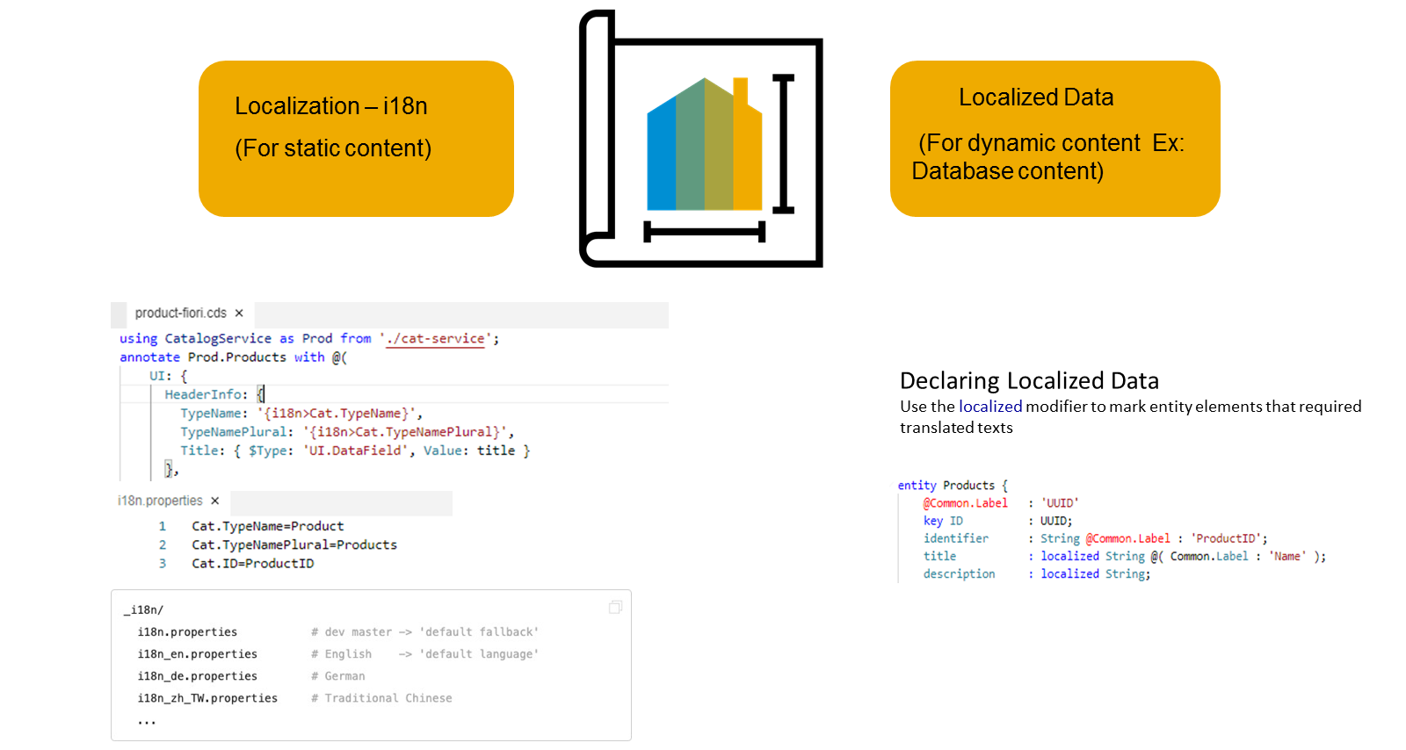
Concept of Localization
Localization refers to adapting your business application to different languages to cater to specific regional markets. This is important for anything that is visible in the UIs.
Localization is split into two categories, Localization for static content and Localization for dynamic content
Localization for dynamic content
This is achieved by marking the attributes that need to support multiple languages with a special keyword called "localized", this then creates a text table for each entity which has attributes defined as "localized"
Dynamic content that depends on the data that is stored in our persistence service.
The attributes that need to support multiple languages need to be marked with a special keyword called "localized", as we see here. In this case a text table is created for the entity.
DESCRIPTION: localized String(255);

Slide 4
Localization for Static Content
This is achieved by externalizing all your text literals into separate text bundle files that we call the internationalization files, or in short, i18n files.
You need to maintain a separate i18n file for each language that you'd like to support.
In these i18n files, we store the actual static text as key and value pairs. Your code can then refer to the respective keys as we see here in this picture.

Slide 5

Exercise
Now we will use the annotation to give labels to the entities in our datamodel. To check the labels in the metadata we have implement a service and expose the business partner entity in the service.
Part 1: Annotating the entity in the same file
Exercise code/resource:
datamodel.cds
CatalogService.cds
CatalogService.js
i18n.properties
Part 2: Annotating the properties from another file.
Exercise code/resources:
index.cds
datamodel.cds
i18n.properties
i18n_de.properties

Slide 6
Introduction to Views in SAP CAP
Core Data Service (CDS) Views are virtual data models of SAP HANA which allows direct access to underlying tables of the HANA database.
SAP CDS Views aim to push logic from the application server to the client-side and database. This is defined by SAP as ‘Code -to-Data’ or ‘Code Pushdown’.
Why we need views in a software
They display non-normalized data. The data is spread in multiple tables, and it is difficult for developers to every time write JOINs.
The application needs data which is presentable to user
View gives security because users cannot update data using view
They can aggregate data like find total sales per customer.
Expose columns of technical type to more semantic names

Slide 7
Title
Content

Slide 8
Title
Content

Slide 9
Title
Content

Slide 10

End of Day 5

Slide 11

Questions

Slide 12

Anubhav Oberoy

Slide 13


We’re committed to empower you to be
Most Desirable Resource
through powerful training solutions.
We build the workforce of the future.
250+
Corporate Clients
30,000+
Learners Trained
25000+
Learners Placed
FREE WEBINARS
Sign up for free webinars with industry experts every fortnight!
Enroll Now!
Contact us today!
https://anubhavtrainings.com/

Slide 14




More from AnubhavTrainings.com

Slide 15
Title
Content

